Slide 1
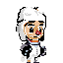
Dangerous Dag’s Adventure
By Robert Adamson

Slide 2

Story Line
Dangerous Dag is on a quest to bake the ultimate pie. Dag heard a rumour that a famed pie maker, Mr. Tarte, is hiding somewhere on Earth. Mr. Tarte is very elusive, but Dag managed to track him down. Mr. Tarte needs Dag to do one special task before he can take Dag on as an apprentice…

Slide 3
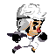
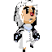

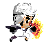
Main Character
Figure 1: Idle Animation
Figure 2: Running Animation
Figure 3: Jumping Animation
Figure 4: Falling Animation
Figure 5: Attack Animation
Dangerous Dag is pie maker. He features a white hat, black fingerless gloves, white pants and black shoes.
Dag is a 64 x 64 model

Slide 4
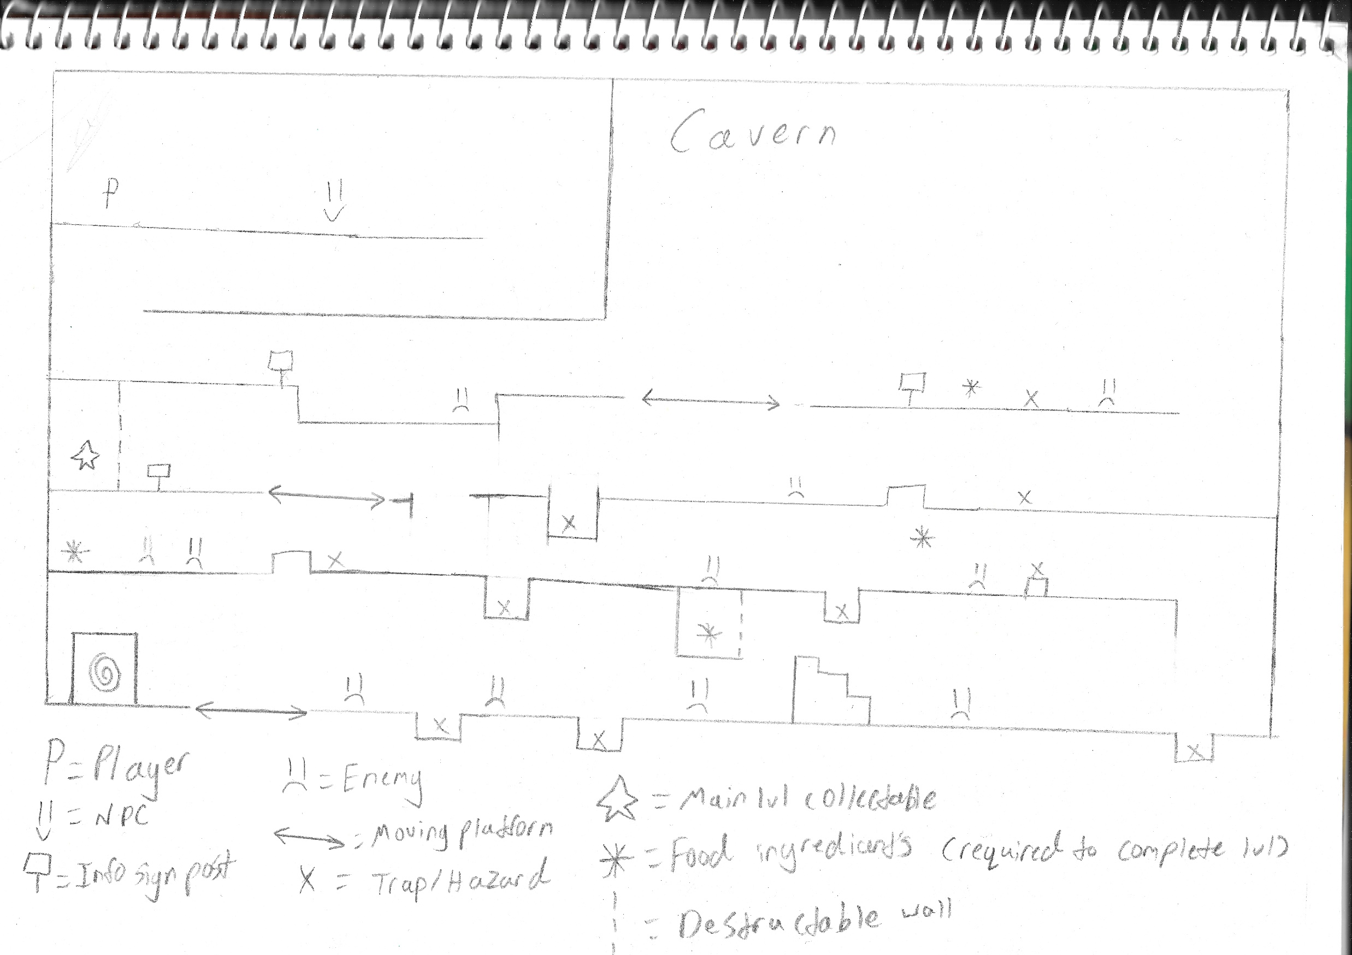
Overall Environment Design (Cavern)

Slide 5
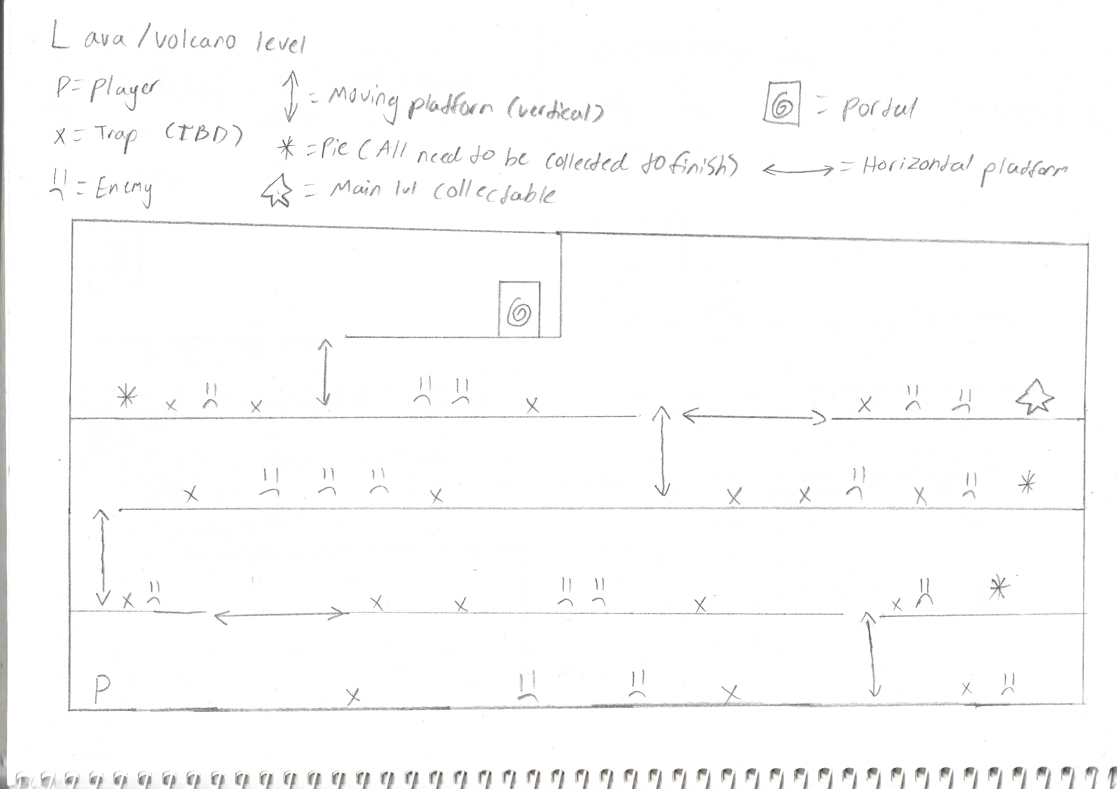
Overall Environment Design (Cave Lvl 2)

Slide 6
Gameplay
Run
Players will run and jump throughout the level.
Dodge
Players will dodge traps.
Attack
Players will attack enemies and gain a few points per enemy.
Collect
Players will collect food items scattered throughout the level which will all need to be collected to finish the level.
Seek out
Players can seek out the bonus collectables worth many points.

Slide 7

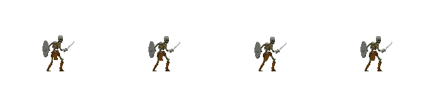
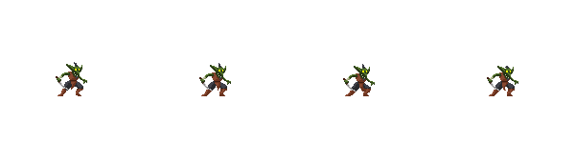

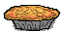


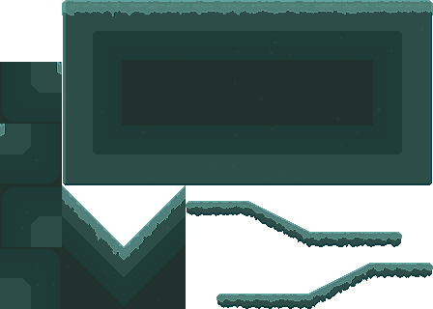


Art
Cavern Enemy
Cavern Enemy (Level 2)
Trap/Environmental Hazard
Collectable Pies
Portal
Main level collectable (x1)
Cavern Level Background
Cavern Level Tile set

Slide 8
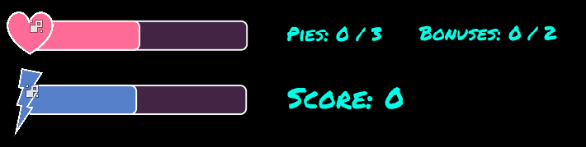
Hud
Dag will have a health bar. To deplete it fully will take approximately 3 hits, at which point Dag will respawn at the start.
Dag will also stamina bar. It will reduce on shooting a fireball, double jumping, or wall jumping. It will regenerate slowly over time.
There will also be a counter displaying the current amount of pies and number to be collected on the right of the stamina and health bar along with a counter showing if you’ve collected the two bonus collectables.

Slide 9
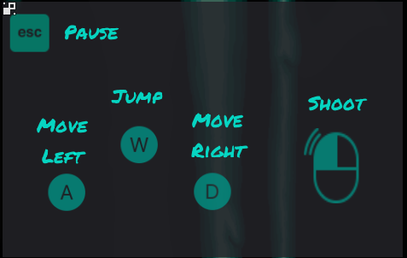
Controls
Doug’s primary controls will be the arrow keys. Left arrow key will correspond to moving left, right arrow key to moving right and up arrow key will make him jump.
Doug’s fireball attack will be initiated by pressing the left mouse button. The player can aim this by moving the mouse. The fireball will shoot to wherever the mouse is.

Slide 10

Music
Sounds
Main Menu:
Goblin:
Skeleton:
Hit:
Hit:
Death Screen 1:
Death:
Death:
Death Screen 2:
Attack:
Game Complete:
Player:
Hit:
Intro & Outro:
Attack:
Levels:
Interstitial 1:

